Slide 1
Syntax Analysis Part III
CHAPTER 4

Slide 2
Bottom-Up Parsing
LR methods (Left-to-right, Right-most derivation)
SLR, Canonical LR, LALR
Other special cases:
Operator-precedence parsing
Shift-reduce parsing

Slide 3
Contd…
S -> aABe
A -> Abc|b
B -> d
abbcde
aAbcde
aAde
aABe
S

Slide 4
OPERATOR GRAMMAR
No Ɛ-transition.
No two adjacent non-terminals.
Eg.
E → E op E | id
op → + | *
The above grammar is not an operator grammar but:
E → E + E | E* E | id

Slide 5
Contd…
The following grammars are not operator grammar:
A -> ε
A -> BC
A -> BCD
E -> E+E|E*E| ε
Operator grammar:
E -> E+E|E*E|id

Slide 6
Contd…
Consider the following grammar:
S->SAS|a
A-> bSb|b
Check the above grammar for operator grammar:
S -> SbSbS|SbS|a
A-> bSb|b

Slide 7
Contd…
Consider the following grammar:
P-> SR|S R -> bSR|bS
S -> WbS|W
W -> L*W|L
L ->id
Convert the following to operator grammar:
P -> SbP|SbS|S
R ->bP|bS
S -> WbS|W
W -> L*W|L
L ->id
In the above grammar, R is useless. Therefore R will be eliminated
P -> SbP|SbS|S
S -> WbS|W
W -> L*W|L
L ->id

Slide 8
OPERATOR PRECEDENCE
If a has higher precedence over b; a .> b
If a has lower precedence over b; a <. b
If a and b have equal precedence; a =. b
Note:
id has higher precedence than any other symbol
$ has lowest precedence.
if two operators have equal precedence, then we check the Associativity of that particular operator.

Slide 9
PRECEDENCE TABLE
 | id | + | * | $
id | - | .> | .> | .>
+ | <. | .> | <. | .>
* | <. | .> | .> | .>
$ | <. | <. | <. | -
Example: w= $id + id * id$
$<.id.>+<.id.>*<.id.>$

Slide 10
BASIC PRINCIPLE
Scan input string left to right, try to detect .> and put a pointer on its location.
Now scan backwards till reaching <.
String between <. And .> is our handle.
Replace handle by the head of the respective production.
REPEAT until reaching start symbol.

Slide 11
ALGORITHM
w ← input
a ← input symbol
b ← stack top
Repeat
{
if(a is $ and b is $)
return
if(a .> b)
push a into stack
move input pointer
else if(a <. b)
c ← pop stack
until(c .> b)
else
error()
}

Slide 12
EXAMPLE
STACK | INPUT | ACTION/REMARK
$ | id + id * id$ | $ <. Id
$ id | + id * id$ | id >. +
$ | + id * id$ | $ <. +
$ + | id * id$ | + <. Id
$ + id | * id$ | id .> *
$ + | * id$ | + <. *
$ + * | id$ | * <. Id
$ + * id | $ | id .> $
$ + * | $ | * .> $
$ + | $ | + .> $
$ | $ | accept

Slide 13
PRECEDENCE FUNCTIONS
Operator precedence parsers use precedence functions that map terminal symbols to integers.
Algorithm for Constructing Precedence Functions
Create functions f_{a} for each grammar terminal a and for the end of string symbol.
Partition the symbols in groups so that f_{a} and g_{b} are in the same group if a =· b (there can be symbols in the same group even if they are not connected by this relation).
Create a directed graph whose nodes are in the groups, next for each symbols a and b do: place an edge from the group of g_{b} to the group of f_{a} if a <· b, otherwise if a ·> b place an edge from the group of f_{a} to that of g_{b}.
If the constructed graph has a cycle then no precedence functions exist. When there are no cycles collect the length of the longest paths from the groups of f_{a} and g_{b} respectively.

Slide 14
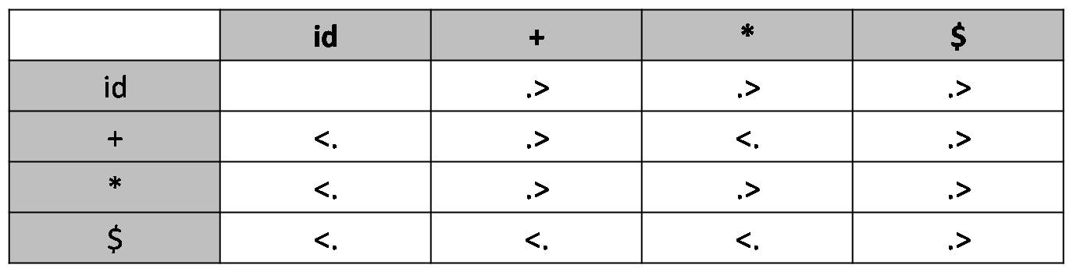
Consider the following table:
Resulting graph:
g_{id}
f_{id}
f*
g*
g₊
f₊
f$
g$

Slide 15
From the previous graph we extract the following precedence functions:
 | id | + | * | $
f | 4 | 2 | 4 | 0
g | 5 | 1 | 3 | 0

Slide 16
Shift-Reduce Parsing
Grammar: S → a A B e A → A b c | b B → d
Reducing a sentence: a b b c d e a A b c d e a A d e a A B e S
Shift-reduce corresponds to a rightmost derivation: S ⇒_{rm} a A B e ⇒_{rm} a A d e ⇒_{rm} a A b c d e ⇒_{rm} a b b c d e
These match production’s right-hand sides
S
A
A
A
A
A
A
B
A
B
a b b c d e
a b b c d e
a b b c d e
a b b c d e

Slide 17
Handles
A handle is a substring of grammar symbols in a right-sentential form that matches a right-hand side of a production
Grammar: S → a A B e A → A b c | b B → d
a b b c d e a A b c d e a A d e a A B e S
Handle
a b b c d e a A b c d e a A A e … ?
NOT a handle, because further reductions will fail
(result is not a sentential form)

Slide 18
Stack Implementation of Shift-Reduce Parsing
Stack
$ $id
$E $E+ $E+id $E+E $E+E* $E+E*id $E+E*E $E+E $E
Input
id+id*id$ +id*id$ +id*id$ id*id$ *id$ *id$ id$ $ $ $ $
Action shift reduce E → id shift shift reduce E → id shift (or reduce?) shift reduce E → id reduce E → E * E reduce E → E + E accept
How to resolve conflicts?
Grammar: E → E + E E → E * E E → ( E ) E → id
Find handles to reduce

Slide 19
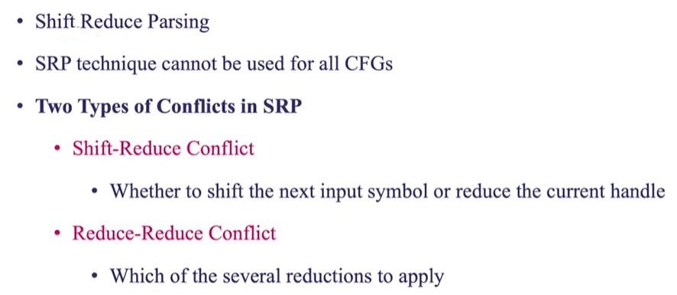
Conflicts in Shift-Reduce Parsing

Slide 20
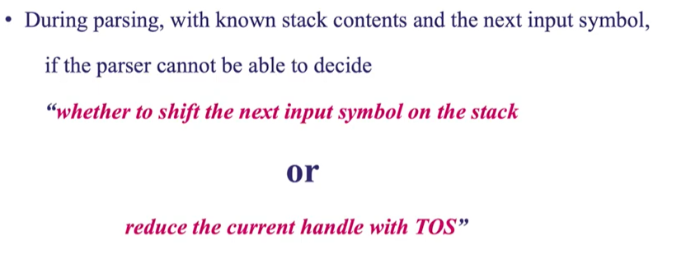
Shift-Reduce Conflict

Slide 21
Shift-Reduce Parsing: Shift-Reduce Conflicts
Stack
$… $…if E then S
Input
…$ else…$
Action … shift or reduce?
Ambiguous grammar: S → if E then S | if E then S else S | other
Resolve in favor of shift, so else matches closest if

Slide 22
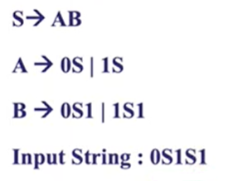
Shift-Reduce Conflict (Example)

Slide 23
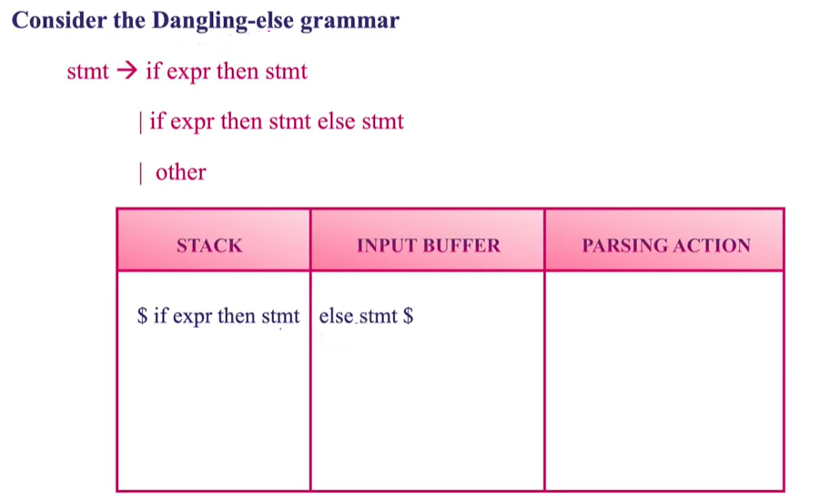
Shift-Reduce Conflict (Example)

Slide 24
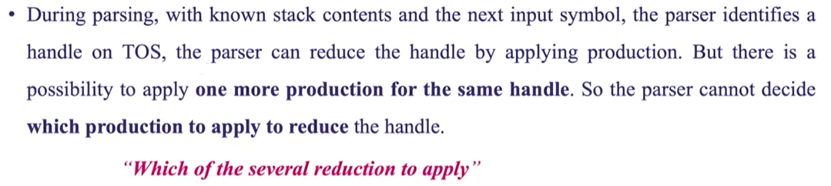
Reduce-Reduce Conflict

Slide 25
Shift-Reduce Parsing: Reduce-Reduce Conflicts
Stack
$ $a
Input
aa$ a$
Action shift reduce A → a or B → a ?
Grammar: C → A B A → a B → a
Resolve in favor of reduce A → a, otherwise we’re stuck!

Slide 26
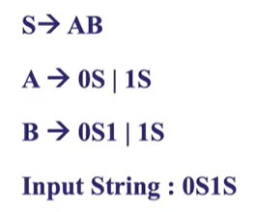
Reduce-Reduce Conflict (Example)

Slide 27
Thank you!!

